Slide 1


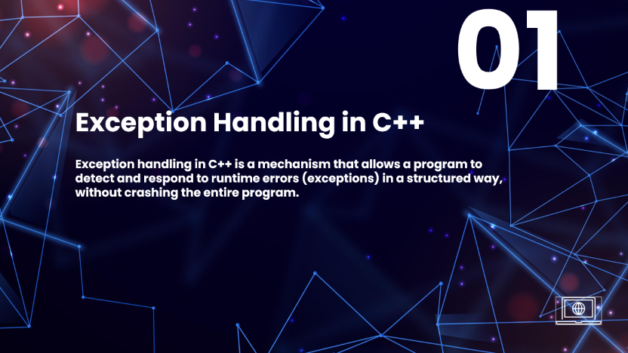

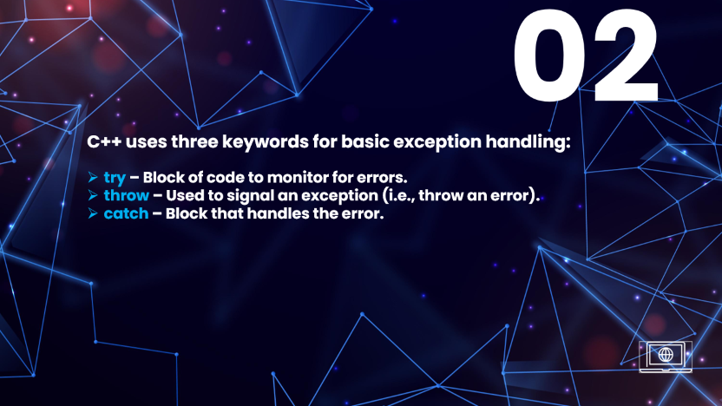


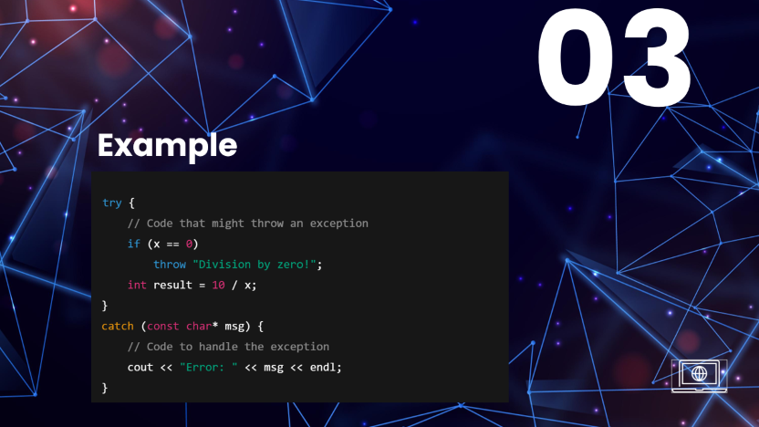

JUST POWERPOINT
Programming
Created by: Elham Sadiqi
PREV
NEXT

Slide 2
JUST POWERPOINT
Programming
Created by: Elham Sadiqi
PREV
NEXT

Slide 3
JUST POWERPOINT
Programming
Created by: Elham Sadiqi
PREV
NEXT

Slide 4
JUST POWERPOINT
Programming
Created by: Elham Sadiqi
PREV
NEXT

Slide 5


01
Exception Handling in C++
Exception handling in C++ is a mechanism that allows a program to detect and respond to runtime errors (exceptions) in a structured way, without crashing the entire program.

Slide 6
02
C++ uses three keywords for basic exception handling:
try – Block of code to monitor for errors.
throw – Used to signal an exception (i.e., throw an error).
catch – Block that handles the error.

Slide 7
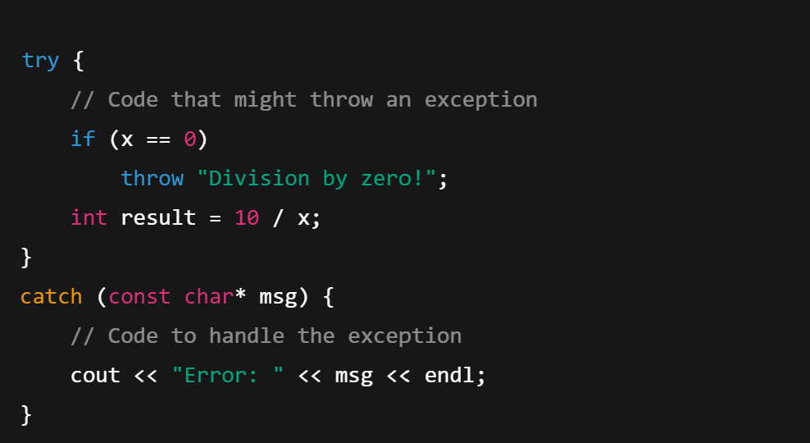
03
Example

Slide 8
04
Benefits:
Prevents program from crashing.
Keeps error handling separate from main logic.
Makes code more reliable and easier to debug.

